Slide 1
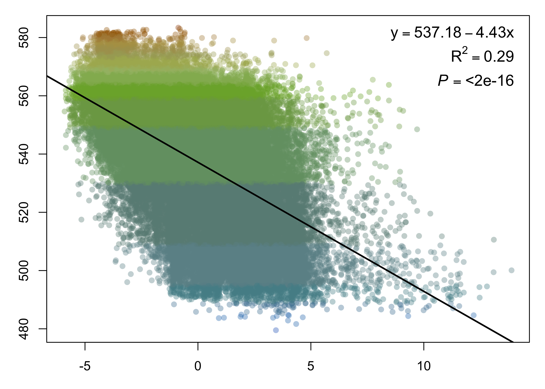
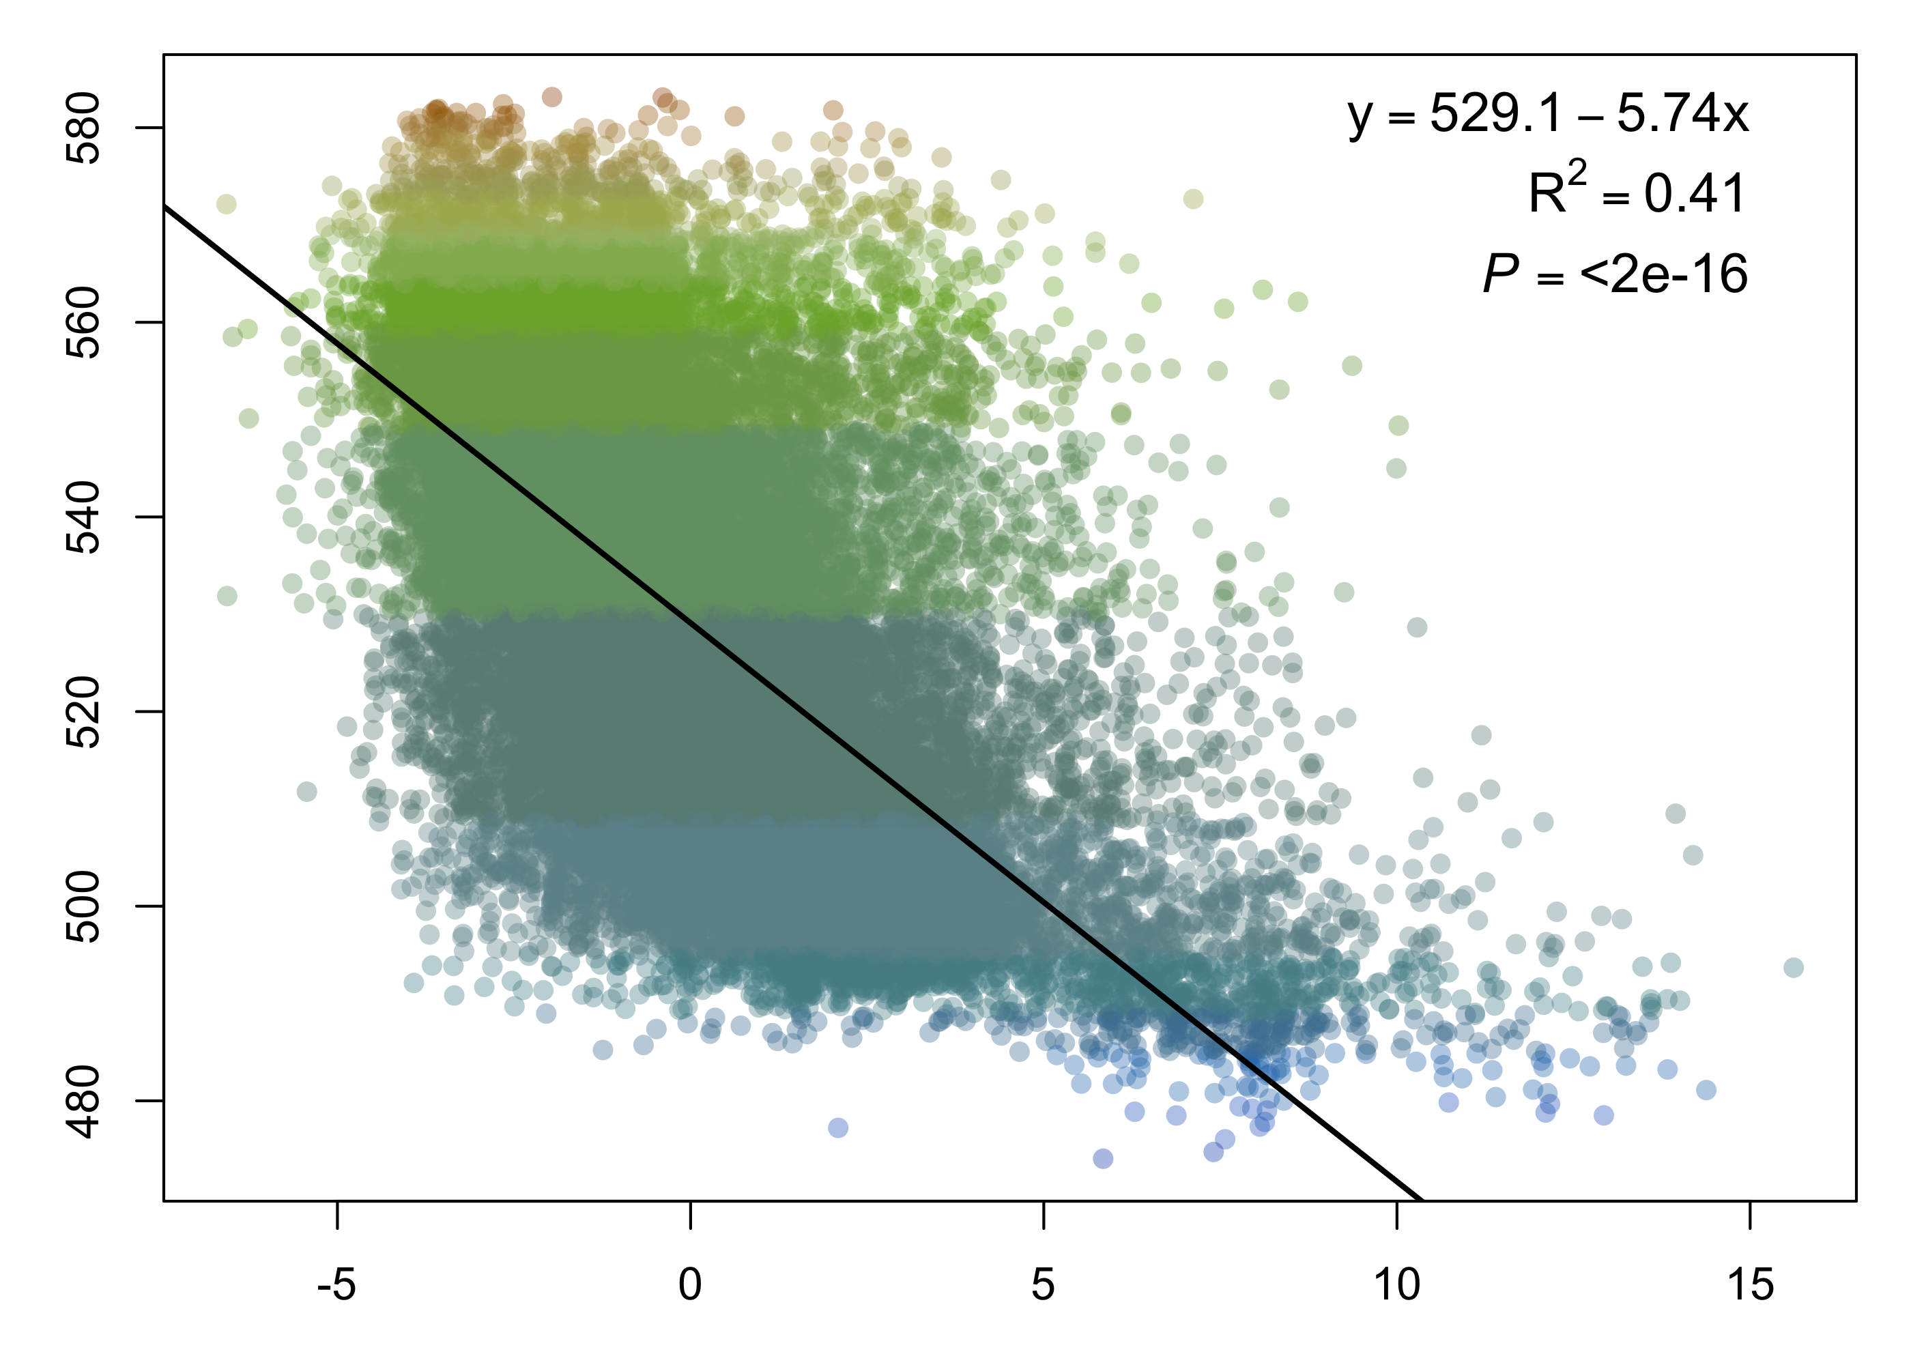
a)
Average lake color (DWL)
PC2
Groundwater recharge (mm/yr)
Runoff (in/yr)
Soil organic carbon (g/kg)
Avg. ann. precipitation (mm/yr)
Soil clay (%)
b)
Average lake color (DWL)
PC2
Groundwater recharge (mm/yr)
Soil coarse (%)
Soil organic carbon (g/kg)
Forest cover (%)
Mean terrain ruggedness index
Notes:
small
avg_ppt groundwaterrecharge_mmperyr runoff_inperyr soil_clay_pct soil_orgcarbon_gperkg
0.2552809 0.2896867 0.2947689 -0.2628248 0.2674841
large
[1] "Principal component 2"
avg_nlcd_forest_pct groundwaterrecharge_mmperyr soil_coarse_pct soil_orgcarbon_gperkg tri_m
0.2762545 0.2891140 0.3152736 0.2643489 0.2712627

